Slide 1
SEM APPROACH TO ANALYZE FACTORS INFLUENCING THE CUSTOMER LOYALTY TOWARDS ONLINE SHOPPING
Under the guidance and supervision of DINESHKUMAR M
DR. P. R. JAYASHREE, M.Sc., M.Phil., M.B.A., Ph.D. (Reg. No.2013212075003)
Assistant Professor, Department of Statistics

Slide 2
OBJECTIVES
To Recognize the factors that affect the significance of a customer loyalty in online shopping
To Investigate customer opinions and perception on the online shopping
To discover the general attitude of customers towards the online shopping.
To find out the consumer behaviour and habits towards online shopping.

Slide 3
Data source
Statistical survey is conducted
Primary data collected through questionnaire method
convenience (non-probabilistic) sampling method has been adopted for choosing the samples
The dataset collected from 250 respondents through Google form and direct interactions in chennai

Slide 4
Methodology
Descriptive statistics
The frequency analysis is carried out to find the percentages using frequency tables
SEM
To construct the structural equation model towards the factors that influence loyalty of customers through online shopping

Slide 5
DESCRIPTIVE STATISTICS
64% of the respondents are male.
36% of the respondents are female.
49.2% of respondents are between the age group of 18-25.
30% of respondents earn monthly income is below 10,000.
45% of respondents earn monthly income above 20,000
39.2% of respondents are using online shopping for 2 Year.
35% of respondents are using online shopping more than 2 years
45.2% of respondents purchase the products through online shopping every month.
32% of respondents spend above Rs.2000 on online shopping

Slide 6
50% of respondents prefer cash on delivery for payment
48.4% of respondents satisfied with online shopping experience.
38.8% of respondents are satisfied with the ease of navigation in online shopping.
39.2% of respondents are satisfied with page load in online shopping.
32.8% of respondents are satisfied with payment options in online shopping.
33.6% of respondents are satisfied with check out process in online shopping.
34.8% of respondents are satisfied with product description in online shopping.
32% of respondents are satisfied with product reviews in online shopping.

Slide 7
30% of respondents are satisfied with product images in online shopping.
38.4% of respondents are satisfied with product range in online shopping.
32% of respondents are satisfied with Product cost in online shopping.
33.6% of respondents are satisfied with shipping cost in online shopping.
31.2% of respondents are satisfied with filter options in online shopping page
34.4% of respondents are satisfied with discounts in online shopping.
38 % of respondents are satisfied with delivery timing in online shopping.
35.2 % of respondents are satisfied with exchange policy in online shopping.

Slide 8
32.8% of respondents are satisfied with payment options in online shopping.
30.8 % of respondents are satisfied with Security of payment method in online shopping.
30.8 % of respondents are never received broken items in online shopping.
31.2% of respondents have rarely experienced bad sales and services in online shopping
28.4% of respondents said that they sometimes need security of payment methods in online shopping.
34% of respondents said that sometimes product information given by the seller is not enough for purchase in online shopping
31.2% of respondents recommend online shopping to their friends and family.

Slide 9
59% of respondents need third party mediator for payment options for online shopping.
65% of respondents are loyal to online shopping
54% of respondents are fill the comments and feedback forms in the online shopping.
81.2% of respondents are using Amazon for online shopping.
78% of respondents are using flipkart for online shopping.
26.4% of respondents are using myntra for online shopping.
11.6% of respondents are using pharmEasy for online shopping
13.6% of respondents are using medplus for online shopping.
20.4% of respondents are using bigbasket for online shopping.
18.8% of respondents are using reliance digital for online shopping.

Slide 10
38.4% of respondents are using Meesho for online shopping.
16.8% of respondents are using Snapdeal for online shopping.
21.6% of respondents are using Ajios for online shopping.
10.8% of respondents are using 1mg app for medicines through online shopping.
17.6% of respondents are using shopclues for online shopping.
17.6% of respondents are using nykaa for online shopping.
24.8 % of respondents buy books using online shopping.
76% of respondents buy electronic items using online shopping.
35.6 % of respondents buy groceries using online shopping.
64 % of respondents buy Apparels and cosmetics using online shopping.
21.6 % of respondents buy medicines using online shopping.

Slide 11
Structural equation modelling
A multivariate statistical analysis technique that is used to analyse structural relationships.
This technique is the combination of factor analysis and multiple regression analysis
It is used to analyse the structural relationship between measured variables and latent variables.

Slide 12
Structural equation modelling
Structural equation modelling was used to analyse the suitability of the model based upon the collected samples.
Structural equations modelling (SEM) with Maximum Likelihood Estimation (MLE) are used for this analysis
Measurement model to test the reliability and validity of the survey instrument was analysed first, and by using R the structural model was analysed.
The structural equation model (SEM) is most useful when assessing the causal relationship between variables as well as verifying the compatibility of the model used(Peter, 2011).

Slide 13
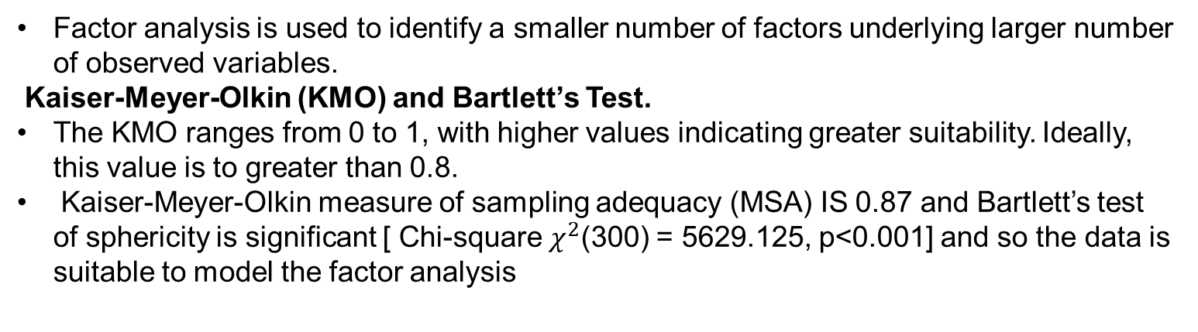
Exploratory factor analysis
Factor analysis is used to identify a smaller number of factors underlying larger number of observed variables.
Kaiser-Meyer-Olkin (KMO) and Bartlett’s Test.
The KMO ranges from 0 to 1, with higher values indicating greater suitability. Ideally, this value is to greater than 0.8.
Kaiser-Meyer-Olkin measure of sampling adequacy (MSA) IS 0.87 and Bartlett’s test of sphericity is significant [ Chi-square $χ^{2}$(300) = 5629.125, p<0.001] and so the data is suitable to model the factor analysis
Kaiser-Meyer-Olkin measure of sampling adequacy |  | 0.87
Bartlett’s test of sphericity | Chi- square | 5629.125
 | Degrees of freedom | 300
 | significance | 0.000

Slide 14
FACTOR LOADINGS
Customer loyalty | component
 | 1 | 2 | 3 | 4 | 5
Product description | 0.54
Product reviews | 0.65
Product image | 0.67
Product range | 0.69
Product price | 0.69
Shipping cost | 0.66
Discount | 0.61
Delivery time | 0.63
Exchange policy | 0.56
Customer care | 0.64
Security of Payment method | 0.66
Ease of navigation | 0.46
Page load |  | 0.85
Payment options |  | 0.88
Check out process |  | 0.85
Filter options |  | 0.86
Satisfied with the security of the payment method in online shopping |  |  | 0.75
Product information provided by the sellers is enough for purchase |  |  | 0.74
Third party mediator for security purpose |  |  | 0.75
Comment/feedback |  |  | 0.95
Overall satisfaction |  |  |  | 0.99
Recommend online shopping |  |  |  | 0.86
Loyalty to online shopping |  |  |  | 0.62
Broken items received in online shopping |  |  |  |  | 0.96
Bad sales on online shopping |  |  |  |  | 0.96

Slide 15
From the above table it is found that 25 variable are reduced to 5 the following factors
FACTOR 1: SERVICE QUALITY explained by
Product description: Text description giving details of the product
Product review: Reviews about the product by existing customers
Product images: Quality of image of the products
Range of products: Number of products offered by the online shopping portal
Ease of navigation: Ease with which a customer is able to find/browse a desired product using the online shopping portal
Price of product: Online price of a product
Notes:
FROM THE ABOVE

Slide 16
Shipping cost: Cost of delivering the product to designated place, which is charged to the customer
Discounts: Regular or seasonal discounts and coupons which can be utilised for shopping
On-time delivery: Punctuality of delivering a product
Customer care: Experience of talking with a customer service executive while resolving a query
Exchange/return policy: Ease with which a customer can return a product if the delivered product is faulty
Product range: Product range refers Variations of single product that are made in order to create similar yet distinctly different products

Slide 17
FACTOR 2: EASE OF USE is explained by
Page load time: Time taken to display the website by the browser
Payment options: Cash on delivery, Net banking, Credit card, etc.
Check-out-process: Ease with which a customer is able to place an order once he/she has selected the product
Filter Options : filters enable users to narrow down a website’s selection of thousands of products to only those few items that match their particular needs and interests.

Slide 18
FACTOR 3: SECURITY is explained by
Product information provided by the sellers is enough for purchase in online
Satisfied with the security of the payment method in online shopping
Third party mediator for security purpose in online shopping
Comment and feedbacks given by the seller after the purchasing the items

Slide 19
FACTOR 4:CUSTOMER LOYALTY is explained by
Overall satisfaction for online shopping
Recommend online shopping to other
Loyalty to online shopping
FACTOR 5:BAD SERVICE is explained by
Bad sales experienced on online shopping
Broken items received in online shopping.

Slide 20
Cronbach’s Alpha reliability test was check whether the stated indicator variables are able to measure the same construct.
Reliability Analysis
Construct Name | Number of attributes | Cronbach’s Alpha
Service quality (T1) | 12 | 0.907
Ease of use(T2) | 4 | 0.974
Security(T3) | 4 | 0.897
Customer Loyalty(T4) | 3 | 0.866
Bad service(T5) | 2 | 0.998
After reliability test is was found that all its Cronbach’s alpha value is greater than 0.8 and therefore SEM analysis can be adopted.

Slide 21
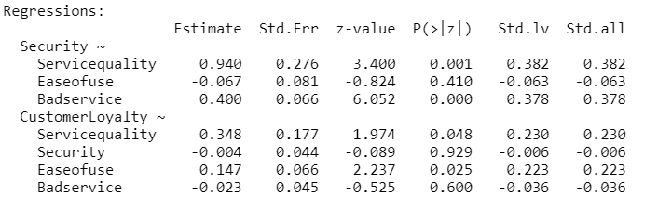

Slide 22
Looking at the above estimates we can conclude that:
Unstandardized coefficient of Service quality on Security is 0.940 represents the partial effect of Service quality on Security, holding the other latent variables as constant. The estimated positive sign implies that such effect is positive that Security would increase by 0.940 for every unit increase in service quality and this coefficient value is significant at 5% level.
Unstandardized coefficient of Ease of use on Security is -0.067 represents the partial effect of Ease of use on Security, holding the other latent variables as constant. The estimated negative sign implies that such effect is positive that Security would decrease by 0.067 for every unit increase in Ease of use and this coefficient value is not significant at 5% level.

Slide 23
Unstandardized coefficient of Bad service on Security is 0.400 represents the partial effect of bad service on Security, holding the other latent variables as constant. The estimated positive sign implies that such effect is positive that Security would increase by 0.4 for every unit increase in Bad service and this coefficient value is significant at 5% level.
Unstandardized coefficient of Service quality on loyalty is 0.348 represents the partial effect of service quality on loyalty, holding the other latent variables as constant. The estimated positive sign implies that such effect is positive that loyalty would increase by 0.348 for every unit increase in service quality and this coefficient value is significant at 5% level.

Slide 24
Unstandardized coefficient of Security on loyalty is -0.004 represents the partial effect of Security on loyalty, holding the other latent variables as constant. The estimated negative sign implies that such effect negative that loyalty would decrease by 0.004 for every unit increase in Security and this coefficient value is not significant at 5% level.
Unstandardized coefficient of Ease of use on loyalty is 0.147 represents the partial effect of ease of use on loyalty, holding the other latent variables as constant. The estimated positive sign implies that such effect is positive that loyalty would increase by 0.147 for every unit increase in ease of use and this coefficient value is significant at 5% level.
Unstandardized coefficient of Bad service on loyalty is -0.023 represents the partial effect of bad service on loyalty, holding the other latent variables as constant. The estimated negative sign implies that such effect negative that loyalty would decrease by 0.023 for every unit increase in bad service and this coefficient value is not significant at 5% level.

Slide 25
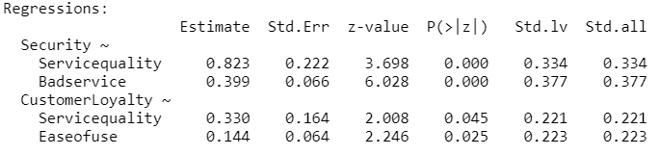

Slide 26
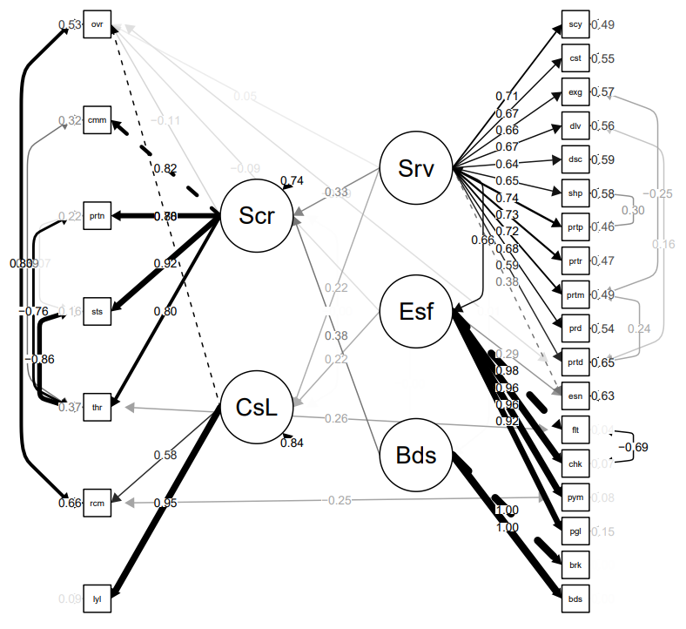

Slide 27


From the relationship between dependent and independent latent variables, path analysis, under SEM, was used with the following model:
${ η}_{1}=0.823{ξ }_{1}+0.399{ξ }_{3}$
$η_{2}=0.330{ξ }_{1}+0.144{ξ }_{2}$
Where,
$η_{1}$=Security
${ξ }_{1}$=Service quality
${ξ }_{2}$=Ease of use
${ξ }_{3}$=Bad service
$η_{2}$₌ Customer loyalty

Slide 28
INDICATORS OF MODEL FIT
Structural equation modelling evaluates whether the data fit a theoretical model.
the purpose of testing the model is to fit null hypothesis and alternative hypothesis are
H_{O}: The hypothesized model has a good fit.
H₁: The hypothesized model does not have a good fit.
The criteria for an acceptable model are as follows: RMSEA of 0.08 or lower: CFI of 0.90 or higher and NFI of 0.90 or higher. The fit between the data and the proposed measurement model can be tested with a chi-square goodness-to-fit (GFI) test where the probability is greater than or equal to 0.9 indicates a good fit (Hu and Bentler , 1999).

Slide 29
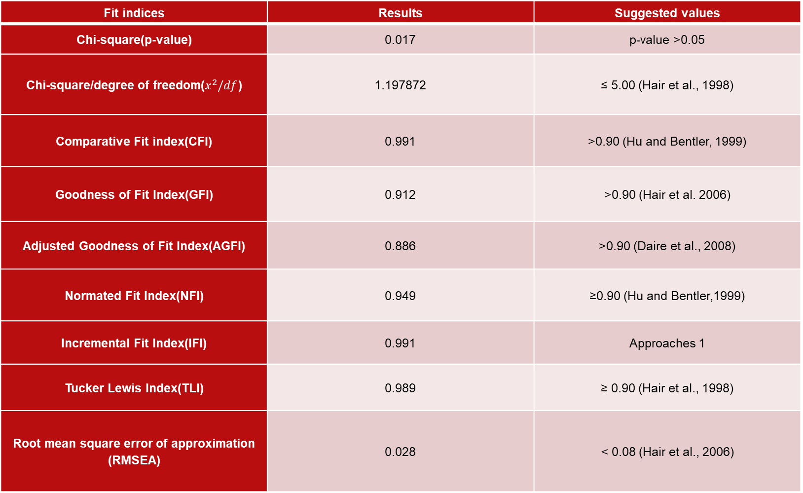
Fit indices | Results | Suggested values
Chi-square(p-value) | 0.017 | p-value >0.05
Chi-square/degree of freedom($x^{2}/df$) | 1.197872 | ≤ 5.00 (Hair et al., 1998)
Comparative Fit index(CFI) | 0.991 | >0.90 (Hu and Bentler, 1999)
Goodness of Fit Index(GFI) | 0.912 | >0.90 (Hair et al. 2006)
Adjusted Goodness of Fit Index(AGFI) | 0.886 | >0.90 (Daire et al., 2008)
Normated Fit Index(NFI) | 0.949 | ≥0.90 (Hu and Bentler,1999)
Incremental Fit Index(IFI) | 0.991 | Approaches 1
Tucker Lewis Index(TLI) | 0.989 | ≥ 0.90 (Hair et al., 1998)
Root mean square error of approximation (RMSEA) | 0.028 | < 0.08 (Hair et al., 2006)

Slide 30
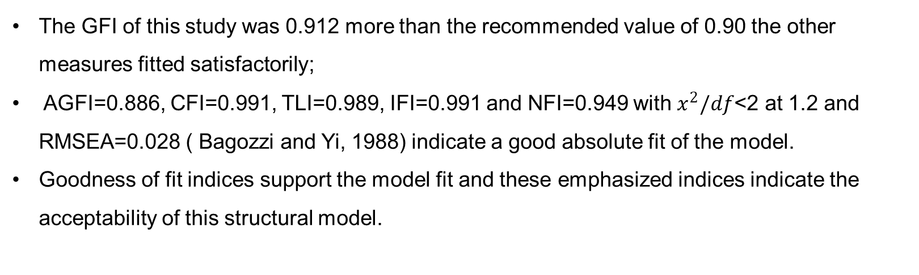
The GFI of this study was 0.912 more than the recommended value of 0.90 the other measures fitted satisfactorily;
AGFI=0.886, CFI=0.991, TLI=0.989, IFI=0.991 and NFI=0.949 with $x^{2}/df$<2 at 1.2 and RMSEA=0.028 ( Bagozzi and Yi, 1988) indicate a good absolute fit of the model.
Goodness of fit indices support the model fit and these emphasized indices indicate the acceptability of this structural model.

Slide 31
Thus, from SEM analysis it was found that
Ease of using an online shopping portal is positively related to the Customer loyalty experienced by a customer while shopping online
Service quality of delivery of product is positively related to the Customer loyalty experienced by a customer while shopping online

Slide 32
LIMITATIONS OF ONLINE SHOPPING
During online shopping, real-time experience on shopping is missed
Delay in delivery of the product to customer’ s doorstep takes about 1-3 weeks during festival times
Product rates are so high, compared to the market price
Products are damaged some times and there is no exchange policy

Slide 33
reference
Hu LT, Bentler PM (1999). Cutoff Criteria for Fit Indexes in Covariance Structure Analysis: Conventional Criteria versus New Alternatives, Struct. Equ. Model. 6(1):1-55.
Hair JF, Anderson RE, Tatham RL, Black WC, Babin BJ (2006). Multivariate Data Analysis, 6th edn., Pearson Education, New Delhi. 734-735
Daire H, Joseph C, Michael RM (2008). Structural Equation Modeling: Guidelines for Determining Model Fit. Electron. J. Bus. Res. Methods 6(1):53-60.

Slide 34
Mulaik SA, James LR, Van Alstine J, Bennet N, Lind S, Stilwell CD (1989). Evaluation of Goodness-of-Fit Indices for Structural Equation Models. Psychol. Bull. 105(3):430-445.
peter T (2011). Adoption of Mobile money technology: Structural Equation Modeling Approach. Eur. J. Bus. Manage. 3(7):2011.
Yulihasri, Islam, M. A., & Daud, K. A. K. (2011). Factors that Influence Customers’ Buying Intention on Shopping Online. International Journal of Marketing Studies, 3 (1), 128-139.
Weisberg, J., Te’eni, D., & Arman, L. (2011). Past purchase and intention to purchase in ecommerce the mediation of social presence and trust. Internet Research, 21 (1), 82-96.
Abadi, H. R. D., Hafshejani, S. N. A., & Zadeh, F. K. (2011). Considering Factors that Affect Users’ Online Purchase Intentions Using Structural Equation Modeling. Interdisciplinary Journal of Contemporary Research in Business, 3 (8), 463-471
Anderson JG, Gerbing DW (1988). Structural Equation Modeling in Practice; a review two step approach. Psychol. Bull. 103:411- 423.

Slide 35
THANK YOU

